Slide 1

The Mortgage Rollercoaster: How Interest Rates Reshape Your Housing Future

Slide 2
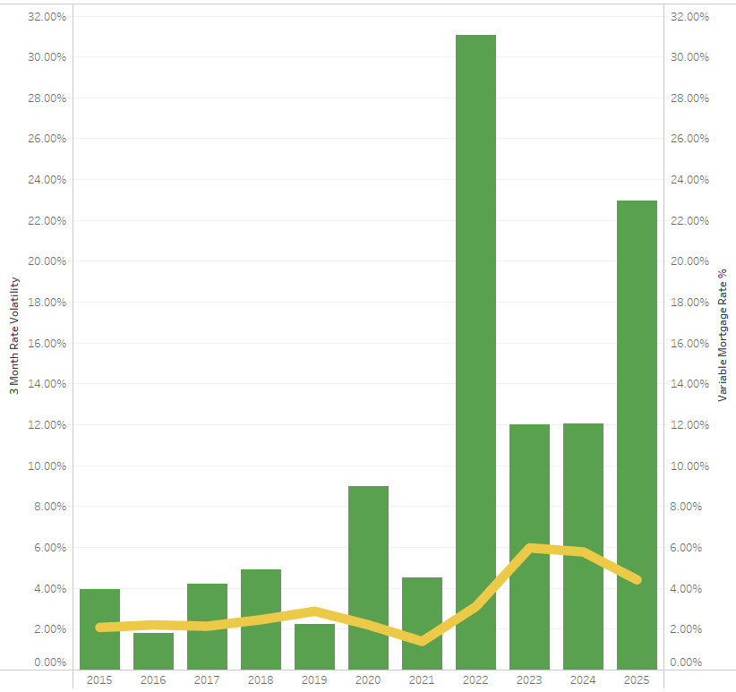
Mortgage Rate Trends and Volatility
Extreme Volatility Spike (2022): Rate volatility reached an unprecedented 31% in 2022, coinciding with mortgage rates tripling from pandemic lows to over 6%.
Three Distinct Eras: The chart shows stable pre-pandemic rates (2015-2019, ~2-3%), historic pandemic lows (2020-2021, ~1.5%), and the high-rate environment (2022-present, peaking above 6%).
Elevated Future Uncertainty: While rates are projected to moderate to ~4.5% by 2025, volatility remains at 23% – significantly higher than pre-pandemic norms, suggesting a "new normal" of market uncertainty.

Slide 3
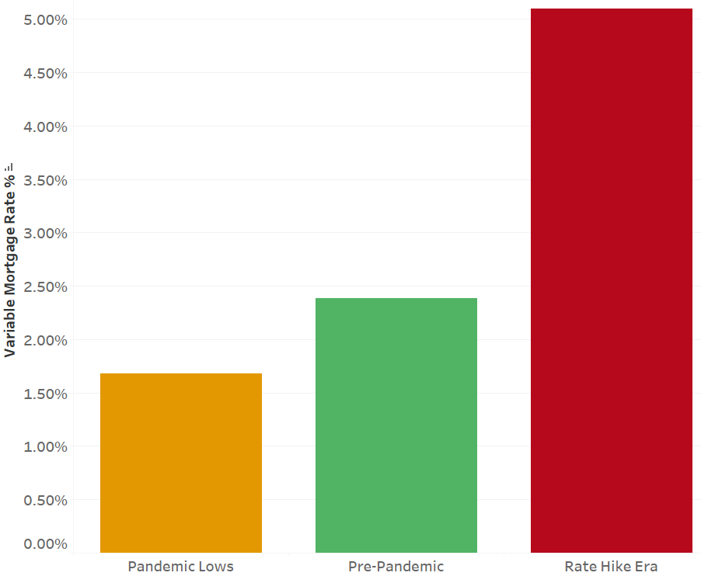
Rate Enironment
Dramatic rate increase: The "Rate Hike Era" shows mortgage rates around 5%, which is approximately 3 times higher than the "Pandemic Lows" of about 1.7%.
Historical comparison: Pre-pandemic rates (around 2.4%) were significantly higher than pandemic lows but still less than half of current rates in the "Rate Hike Era."
Market volatility: The chart illustrates the extreme volatility in the mortgage market over recent years, with borrowers experiencing both historically low rates during the pandemic and then a rapid escalation to multi-year highs.

Slide 4
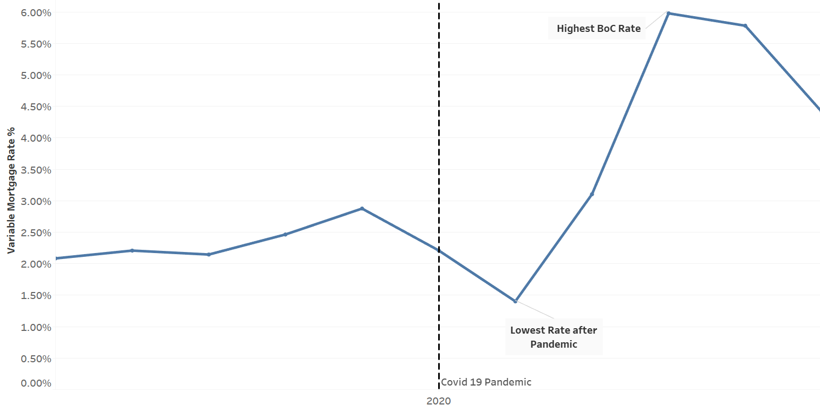
Mortgage Rate Trends
Pandemic Impact: Following the COVID-19 pandemic in 2020, variable mortgage rates dropped significantly to their lowest point (approximately 1.4%), likely reflecting emergency monetary policy measures.
Post-Pandemic Surge: After reaching this low point, rates increased dramatically, more than quadrupling to reach their highest point (around 5.9%) in what appears to be 2022-2023.
Recent Moderation: The most recent trend shows rates beginning to decline from their peak, suggesting a potential shift in monetary policy or economic conditions, though rates remain substantially higher than pre-pandemic levels.

Slide 5
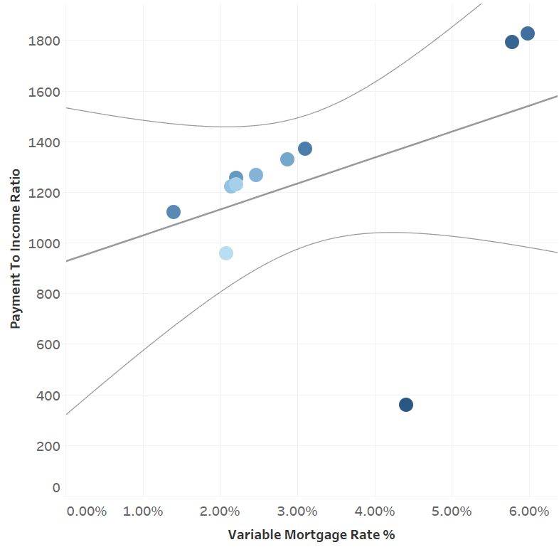
Relationship between Mortgage Rates and Affordability
Positive Correlation Trend: There's a general upward trend showing that as variable mortgage rates increase, the payment to income ratio typically rises as well, indicating greater housing affordability challenges at higher interest rates.
Clustering Pattern: Data points appear to form distinct clusters, with concentration in the 2-3% rate range (payment ratios 950-1400) and another at the 5.5-6% range (payment ratios ~1800), suggesting potential market adjustment periods or policy shifts.
High-Rate Burden: The highest payment-to-income ratios (around 1800) occur at the highest mortgage rates (5.5-6%), demonstrating that when rates reach these levels, households must dedicate a substantially larger portion of their income to mortgage payments.

Slide 6
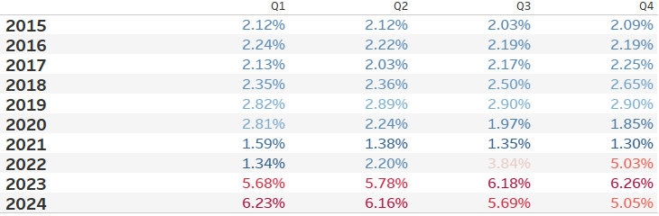
Rate Change by Year and Quarter
Pandemic-Driven Rate Collapse: Rates steadily declined throughout 2020 and reached their lowest point in Q2 2021 (1.38%), reflecting aggressive monetary policy responses to the COVID-19 economic crisis.
Dramatic Post-Pandemic Surge: Starting in Q2 2022, rates began rising sharply, more than quadrupling from 2.20% to 6.26% by Q4 2023, marking one of the most aggressive rate-hiking cycles in recent history.
Recent Moderation Trend: The first signs of rate moderation appear in 2024, with rates declining from 6.23% in Q1 to 5.05% in Q4, suggesting a potential shift in monetary policy as inflation pressures potentially ease.

Slide 7
Looking forward

Slide 8
Thank You

